Slide 1
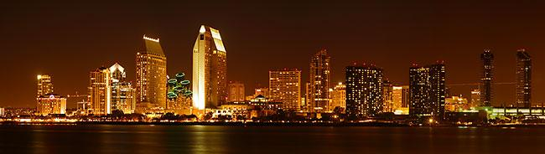
20xx – 20xx ASHRAE Region X CRC – Chapter Summary Report
Name Chapter #
Web address

Slide 2
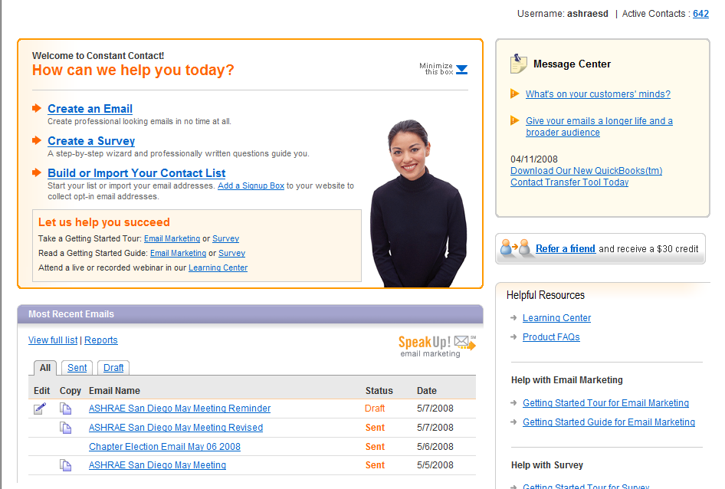
Most Hottest Things
#1 - Web Based Email

Slide 3
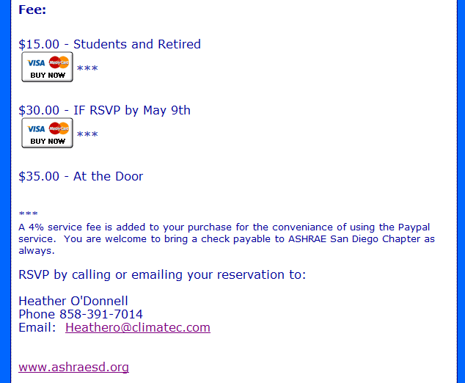
Most Hottest Things
#2 – PayPal Payments

Slide 4
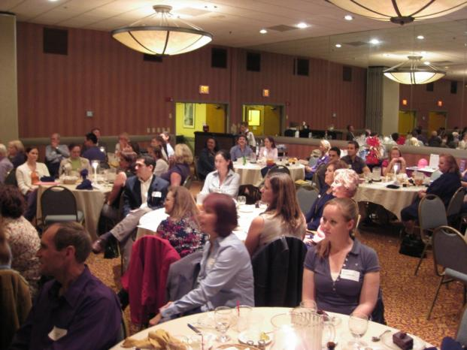
Most Hottest Things
#3 – Joint Meetings
Joint Meeting With NAWIC
Attendance Over 120 People

Slide 5
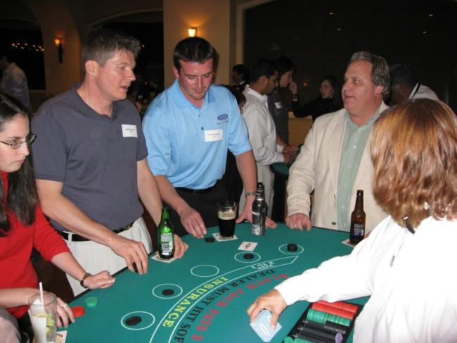
Most Hottest Things
#4 – Research Promotion Event
Holiday – Casino Night
70 Attended
Netted $6,000
For Research Promotion

Slide 6
Most Challenging Issue
New Board Members
Research Promotion Chair

Slide 7
San Diego Chapter
Membership Promotion
 | YTD Reported 2006/07 | Reported 2005/06 | Reported 2004/05
Area Assigned Members | 392 | 361 | 385
Chapter Dues Paying Members | 307 | 282 | 285
New Members | 41 | 21 | 29
Delinquent Members | 41 | 27 | 56

Slide 8
San Diego Chapter
Student Activities
 | YTD Reported 2007/08 | Reported 2006/07 | Reported 2005/06
Number of New Student Members | 6 | 1 | 8
Number of Active Student Branches | Possibly UCSD | No Student Branch | No Student Branch
Did you hold a student night? | Yes | Yes | Yes

Slide 9
San Diego Chapter
Chapter Technical Transfer
 | YTD Reported 2007/08 | Reported 2006/07 | Reported 2005/06
Number of Chapter Technology Awards | 0 | 0 | 0
Number of Refrigeration Presentations | 0 | 1 | 2
Government Activities or interface? | 0 | 2 | 1

Slide 10
San Diego Chapter
Chapter Program Activities
 | YTD Reported 2007/08 | Reported 2006/07 | Reported 2005/06
Number of Chapter Technical Sessions, Technical Seminars, Programs or Tours | 10 | 10 | 10
Number of Social Events (I.e. Golf, Spouse Events, Etc.) | 6 | 6 | 6
Average Chapter Monthly Meeting Attendance | 69 | 38 | 45

Slide 11
San Diego Chapter
Research Promotion Fundraising
 | YTD Reported 2007/08 | Reported 2006/07 | Reported 2005/06
Chapter Goal | $22,000 | $20,900 | $16,583
Dollars Collected | $8,922 ($14,672) | $28,555 | $13,528
Dollars / AAM | $19.70 ($32.39) | $44.20 | $37.68

Slide 12
San Diego Chapter
Chapter History
 | YTD Reported 2007/08 | Reported 2006/07 | Reported 2005/06
Chapter Historical Display at CRC | Yes | No | Yes
Chapter History on Website | No | No | No

Slide 13
San Diego Chapter
Finances
 | YTD Reported 2007/08 | Reported 2006/07 | Reported 2005/06
Total Fund Balance | $64,701.58 | $19,560 | $9,640
Chapter Dues | $35.00 | $30.00 | $30.00
Members’ Cost of Meals | $30.00 | $30.00 | $30.00
Date of Last Chapter Audit | N/A | October ‘07 | November ‘06
Chapter Foundation? | Yes | Yes | Yes

Slide 14
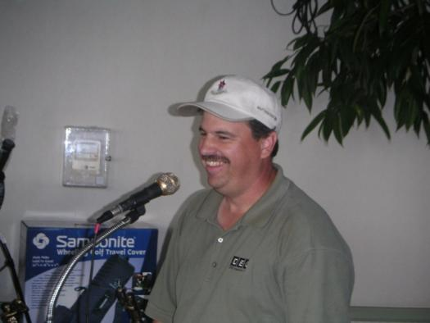
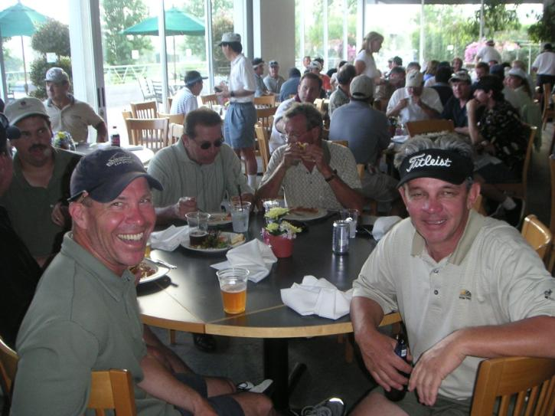
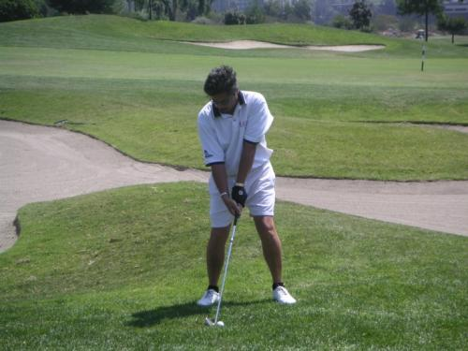
San Diego Chapter
Other Chapter Activities
Golf Tournament

Slide 15
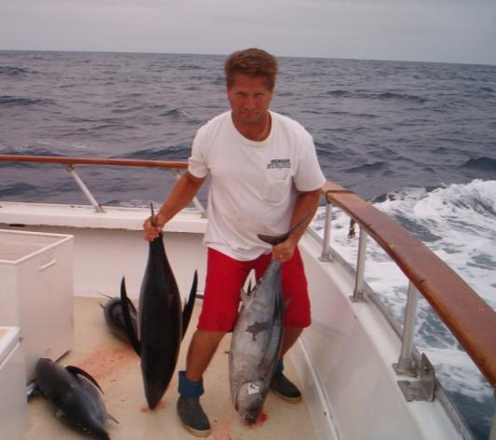
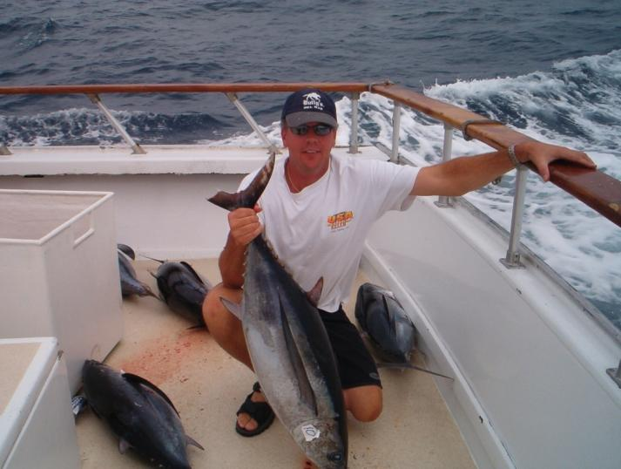
San Diego Chapter
Other Chapter Activities
4nd Annual Fishing Trip

Slide 16
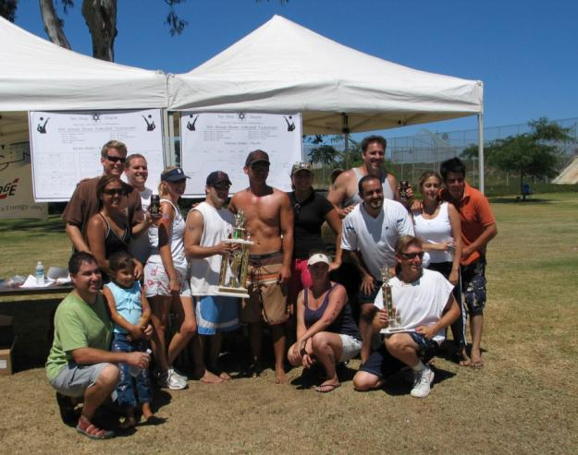
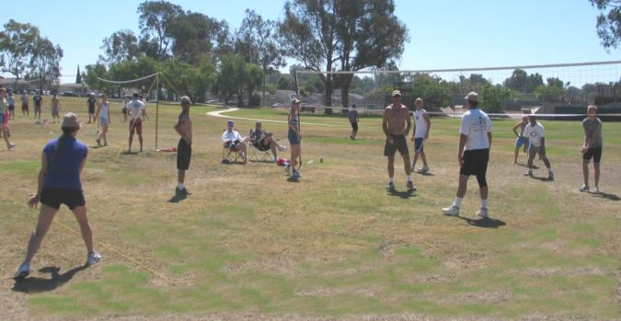
San Diego Chapter
Other Chapter Activities
Annual Volleyball Tournament

Slide 17
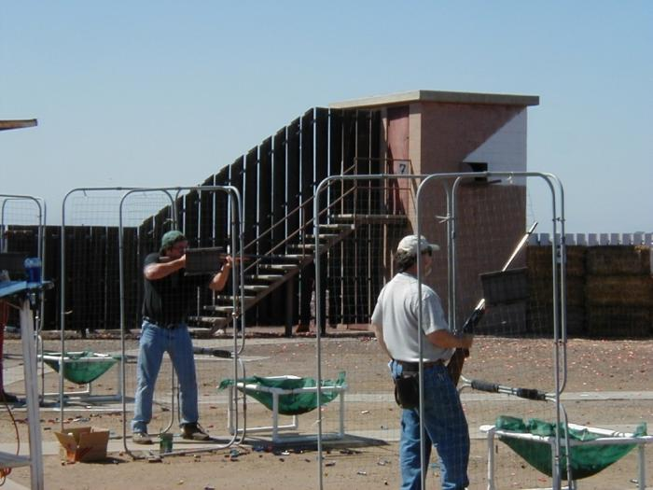
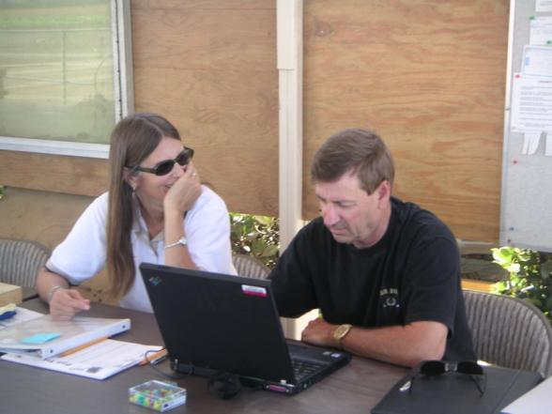
San Diego Chapter
Other Chapter Activities
6th Annual Trap and Skeet Tournament

Slide 18
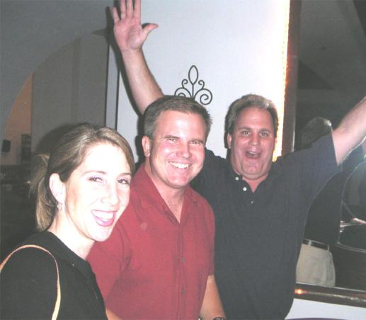
San Diego Chapter
Other Chapter Activities
Holiday Party / Casino Night

Slide 19
San Diego Chapter
Other Chapter Activities
Participation in National Engineer’s Week

Slide 20
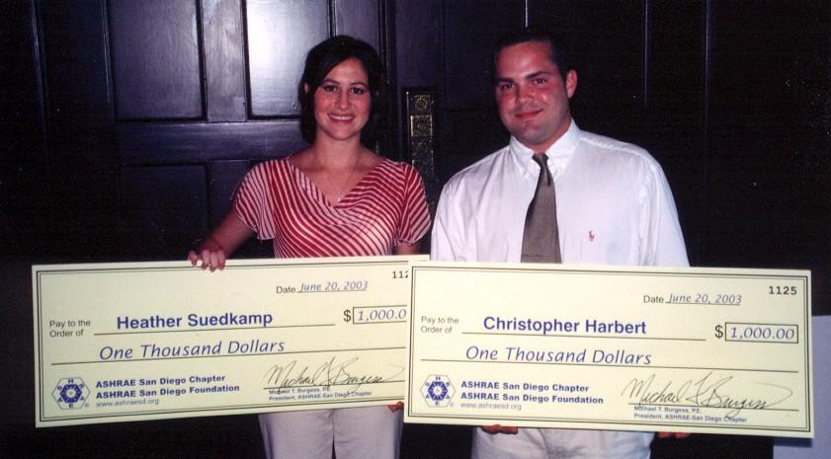
San Diego Chapter
Other Chapter Activities
The Chapter’s scholarship program benefiting engineering students at local Universities

Slide 21
The End

Slide 22
Chapter’s Name
Highlights-
Challenges-
Solutions-

